Slide 1


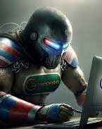
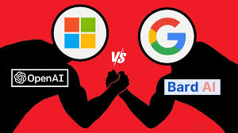
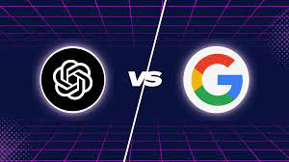

The Future of the InTErnet/ The AI War
This Photo by Unknown Author is licensed under CC BY-SA

Slide 2
INDEX
Cause of bard’s failure
Threats to google
Gemini AI
How to make money out of AI ?
Google’s target audience
Grabbing the market ?
AI for developers?
Final conclusion

Slide 3
WHAT IS CAUSE OF BARD’S (GOOGLE)FAILURE IN THE MARKET ?
Cause of failure of google in ai market
Rise of chat gpt
Failure of bard

Slide 4
WHAT IS CAUSE OF BARD’S (GOOGLE)FAILURE IN THE MARKET ?
One of the main reason for the bard failure was the presence of Chatgpt , AI chatbot launched by openai(backed by Microsoft)
Since then Microsoft has integrated Chatgpt with its various products which are commonly in day to day life.
ChatGPT functions are already enabled in Microsoft Teams, its collaborative working environment featuring virtual conferencing and video calling functionality
The Power apps are focused on the no-code/low-code concept, allowing users to create their own applications or set up complex automated processes but integrating chatgpt has deacreased further complication and made it easy for users
Also it can be used to write emails and formatting excel sheets make it looks more attractive

Slide 5
WHAT IS CAUSE OF BARD’S (GOOGLE)FAILURE IN THE MARKET ?
Also many business have benfitted from it by applying it in customer services
As most of the Microsoft software are used in many of the businesses and company it has benefitted hugely from it
Seamlessly merging the power of ChatGPT with Knowledge Management Systems (KMS) revolutionizes customer interactions
Chatgpt have much powerful integration with many softwares than bard
Also chatgpt can generate ai images better than bard
Chatgpt show more statistical data but google shows more humanly data .In coming future as the chatgpt become more intelligent its data will become more relevant .
All these features have made chatgpt more attractive to larger audience

Slide 6
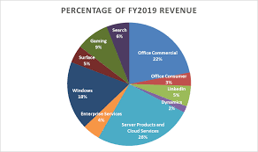
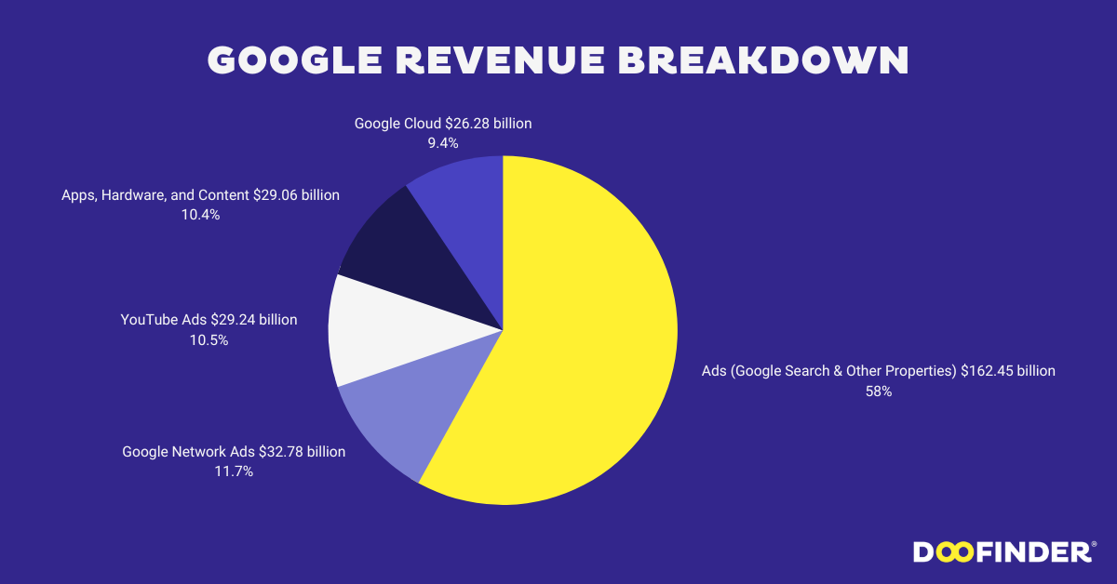
WHAT IS CAUSE OF BARD’S (GOOGLE)FAILURE IN THE MARKET ?
One of the main reason for google’s failure was the ai launch by google engineers which was shut down due to safety issues and wrong information shown by bard about james telescope
Now let us compare the revenue system of both the companies.
For search engine, we can see 58%o google income depend on it but for Microsoft it is only 6%

Slide 7
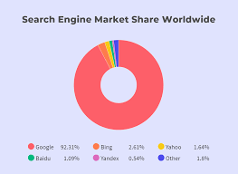
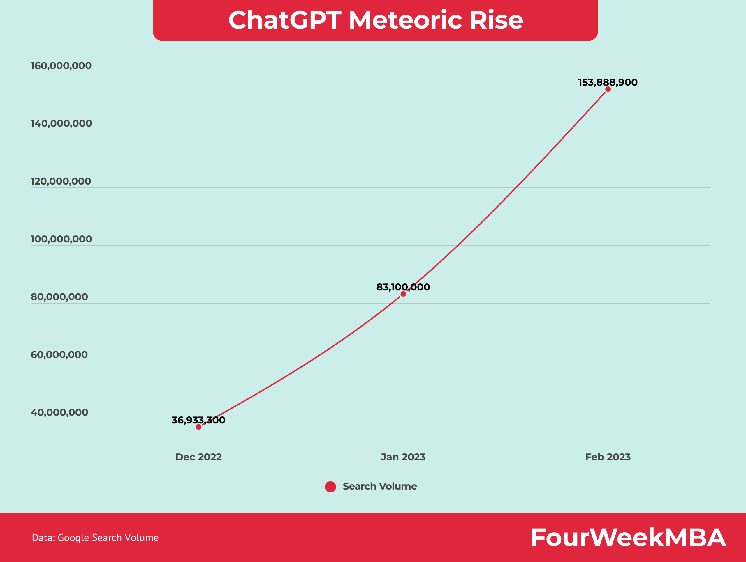
WHAT IS CAUSE OF BARD’S (GOOGLE)FAILURE IN THE MARKET ?
Here we can see google’s market share
in search engine is whopping 92.31%
Whereas for binge is 2.61%.
But as the use chatgpt is resing exponentially in future it will become a huge challenge for google also as its major source of income will hit very badly

Slide 8
THREATS FOR GOOGLE DUE TO AI?
As google income is more based on revenue it earns from advertisements runs on it search engine,use of chatgpt can change the whole equation of search engines
Also companies can launch similar products like google and integrate it with ai to enhance it powers causing further threats to google
A mojor chumk of google revenue is also from youtube so if ai tap the market of video sharing platform then it will cause huge disadvantage to google

Slide 9
GEMINI AI:GOOGLE’S COMEBACK ?
Gemini ai is the prove to be comeback for google in AI field
It is most advanced ai tool available in market
There are three verions of gemini ai
First is used in gemini nano(can be used in android and it can be used without internet)
Second is Gemini pro(brain behind google’s ai service)
Third is gemini ultra(designed for business and data centres)
Also it is able to attract many investor attention due to its amazing capabilities.

Slide 10
How TO MAKE MONEY OUT OF AI?
As AI is not limited to only to search engine,it can be used in almost very field.
Its still in development stage but as it progresses we can surly say in the next 10 y gears the company that will make most use of it will surely be the market leader if the future
As google is the leading company in tech world it also become very important for it to make full use of it

Slide 11
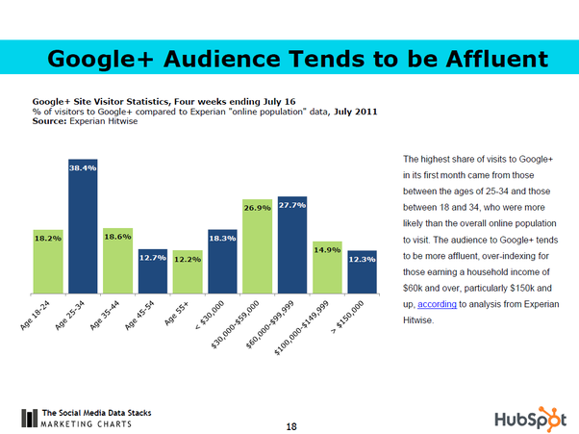
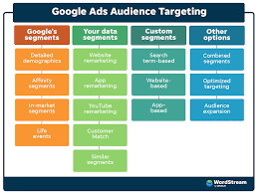
GOOGLE’S TARGET AUDIENCE
Google’s target market is vast and encompasses almost everyone with access to the internet. The company has a wide range of products and services that cater to different needs, which is why its target market is so large.
Google users are primarily from the upper middle class. People in the industry are generally educated or technologically savvy. Most Google users are business-minded individuals who use the internet for business purposes.
There is no definitive answer to google’s target audience as Google segmentation strategies are constantly evolving. However, some methods that Google has used in the past to segment the market include targeting specific demographics, geographic regions, and user interests. There is no definitive answer to this question as Google segmentation strategies are constantly evolving. However, some methods that Google has used in the past to segment the market include targeting specific demographics, geographic regions, and user interests.

Slide 12
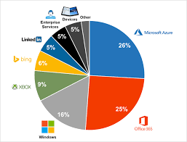
Grabbing the market ?
If we again see Microsoft revenue share
We can see most of the revenue of the mcrosoft is from office 365 and Microsoft azure
These two products are mostly use by a large no. of business and companies

Slide 13
Grabbing the market ?
If we see google’s revenue framework ,its major revenue is from the advertisement that runs on its search engine.
To grab ai market it become very important to make companies and business make use your ai market as they are the ones whoe are gonna use ai at very large level
Therefore Microsoft is at very ahead in its ai game.
For google it become important to make its office use product more advance with ai and promote it.

Slide 14
Excel vs GOOGLE SHEETS
MARKET SHARE OF EXECEL IS 12.57%
Extensive library of formulas; includes advanced functions and statistical tests
Advanced AI capabilities built into the platform, offering deep data insights, complex analysis, and predictive assistance; designed to augment Excel's powerful data manipulation toolkit
MARKET SHARE OF GOOGLE SHEETS IS 5%
Extensive library of formulas; lacks some statistical tests and functions
A growing set of AI features focused on accessibility and simplicity; capable of generating plans from prompts and aims to improve data organization and analysis

Slide 15
GRABBING THE MARKET?
Microsoft ha using AI extensively in excel therefore google also has to make fast and reliable changes in google sheets to make it more mainstream
More over ai has to be inculcated in gmails also as it is theone of the most important tools n todays world
Also AI has to be used to be in analytics toolprovided by google so it can also give some advice to people in business and content creation.

Slide 16
AI FOR DEVELOPERS ?
AI is reshaping the way developers approach software creation, making processes more efficient, and enabling the development of more intelligent and user-centric applications.
AI has helped devlopers making code more better and helps them finding mistakes faster
AI plays a crucial role in software testing and quality assurance. AI-powered testing tools can generate test cases automatically, execute tests across various scenarios, and analyze test results in real time.

Slide 17
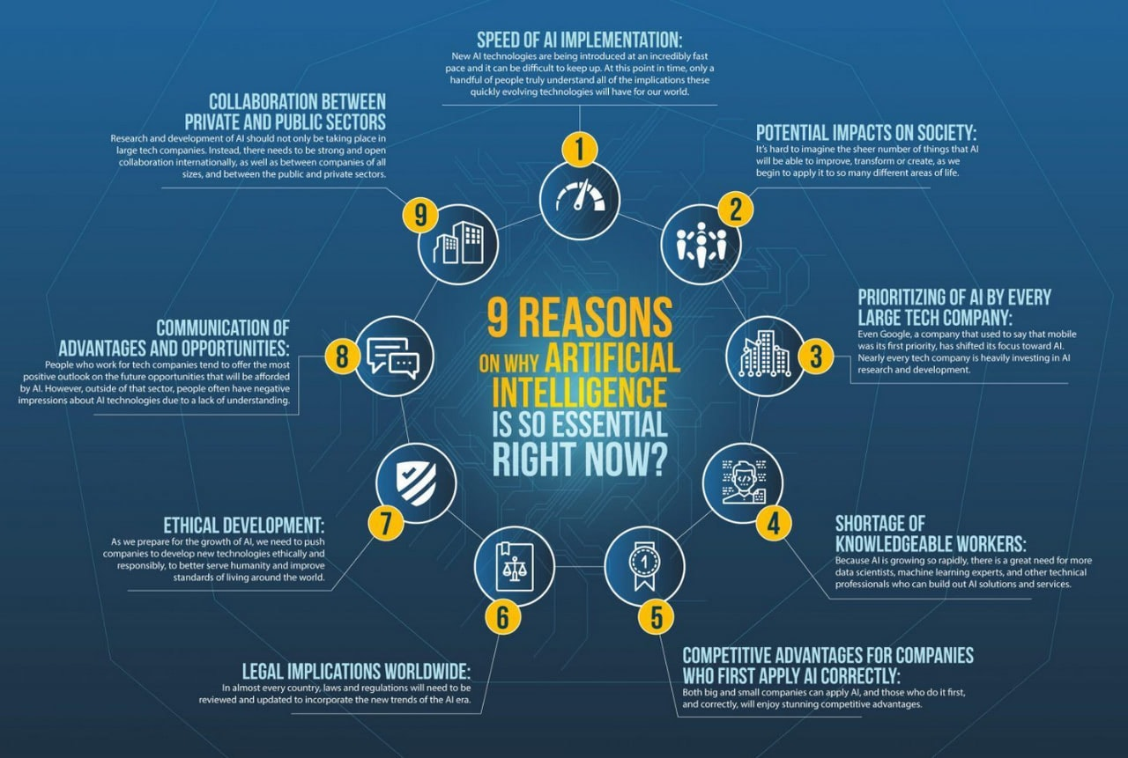
AI FOR DEVELOPERS ?

Slide 18
AI FOR DEVELOPERS ?
As AI will become an important partner for human in programming they need to be developed that way also
Google should include AI in the developing tools it provide developers
AI should be helpful to them and guide them time to time
AI shoulds also give them meaningful insights about their code

Slide 19
Final conclusion
Google should start making their ai more optimize in search engines
They should see that besides they are market leader in search engine they should use AI to make it more optimize
Google should also develop more products for company and business use and make it more useful by using AI
Google also use AI in developing tools

Slide 20
APPendix
..
https://www.zdnet.com/article/microsoft-apple-and-google-where-does-the-money-come-from/
https://www.doofinder.com/en/statistics/google-revenue-breakdown
https://www.chatsimple.ai/blog/industry-report-of-chatgpt-application-market-share-tables-chatgpt-application
https://woodwardavenue.org/what-is-googles-target-market/
https://zapier.com/blog/google-sheets-vs-excel/

